Slide 1


Latest Developments in AI-related Tools for
Trademark Examination
CHINESE TAIPEI
2026 APEC/IPEG
Image Generated by Gemini

Slide 2
Application to Registration Process
File Application
1. Goods and Services Name Assistant (Internal Use)
Formality Check
2. AI-driven Image Search (Beta) (External & Internal Use)
Substantive Examination
Decision
Trademark Registered
Application Rejected

Slide 3

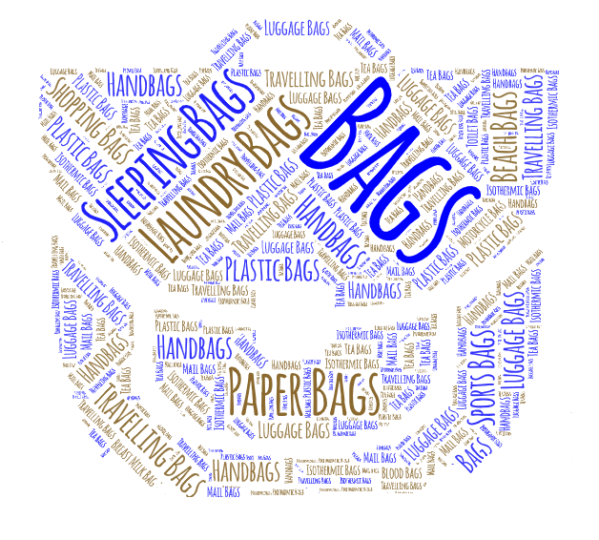
1. Goods and Services Name Assistant (Internal Use)
Image Generated by Gemini and wordart.com

Slide 4
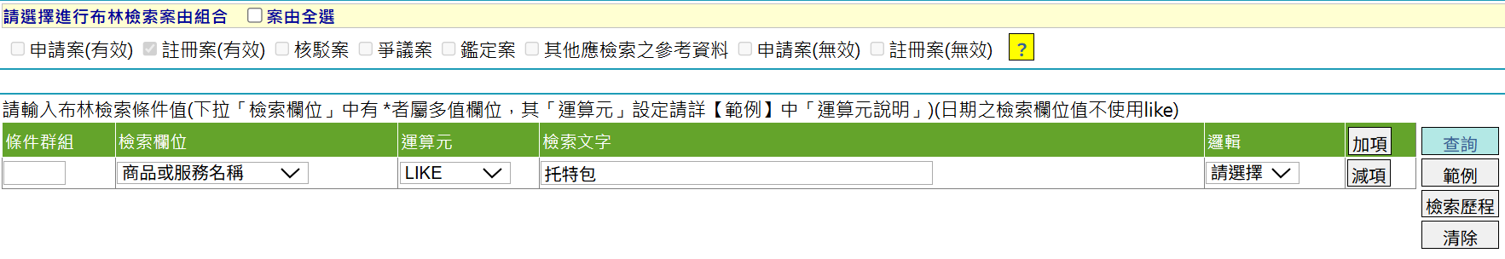
G/S Previous Approach (Internal)
1. G/S Code Finder (system 1)
－String match rule
－Similar term rule
PRE-CODED LIST (STACK)
Selective Nice terms
Pre-coded terms
Stop-list terms
2.Boolean method (system 2)
REGISTERED MARK DATABASE
Accepted variants
tote bags
Open up a case
G/S names
handbags
tote bags

Slide 5
Our Goal and Development Team
New Application - G/S Descriptions
In-house IT (database integration)
Trademark examiners (UI design)
PRE-CODED LIST (STACK)
REGISTERED
MARK DATABASE
Selective Nice terms
Pre-coded terms
Stop-list terms
Accepted variants
Outsourced IT vendor (model options)
5

Slide 6
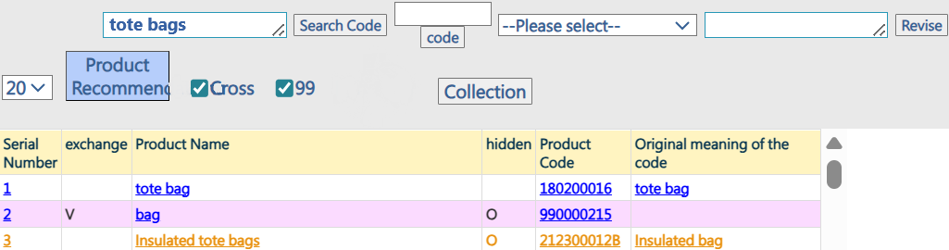
Features of G/S Name Assistant (Internal)
Maintain G/S Code Finder
Integrate more databases
Edit Distance Algorithm
Color-coded User Interface (UI) Design
Decision support only
UI screenshot
G/S Code Finder
🆕G/S Name Assistant

Slide 7
Encouraging Results (Internal)
Reduction in manual G/S Boolean searches
2025 Average activations : 7,005 times per month
Reduction in manual G/S Boolean searches (Table on the Right)
Zero negative feedback from examiners
Examiner | 2024.10 (Before) | 2025.10 (After) | SAVED BOOLEAN
1 | 226 | 96 | -57.52%
2 | 54 | 46 | -14.81%
3 | 149 | 101 | -32.21%
4 | 68 | 108 | 58.82%
5 | 38 | 16 | -57.89%
6 | 45 | 12 | -73.33%
7 | 395 | 289 | -26.84%
8 | 779 | 125 | -83.95%
TOTAL | 1754 | 793 | -54.79%

Slide 8

2. AI-Driven Image Search (Beta) (External & Internal Use)
Image Generated by Gemini

Slide 9

Keys to Conducting AI Image Search
Visual Representation
Ranking
Query Image converted into a visual representation can be compared to images in the DB. The images shall then be ranked by their degree of similarity.
Image converted to a characteristic vector that can be computed and analyzed.

Slide 10
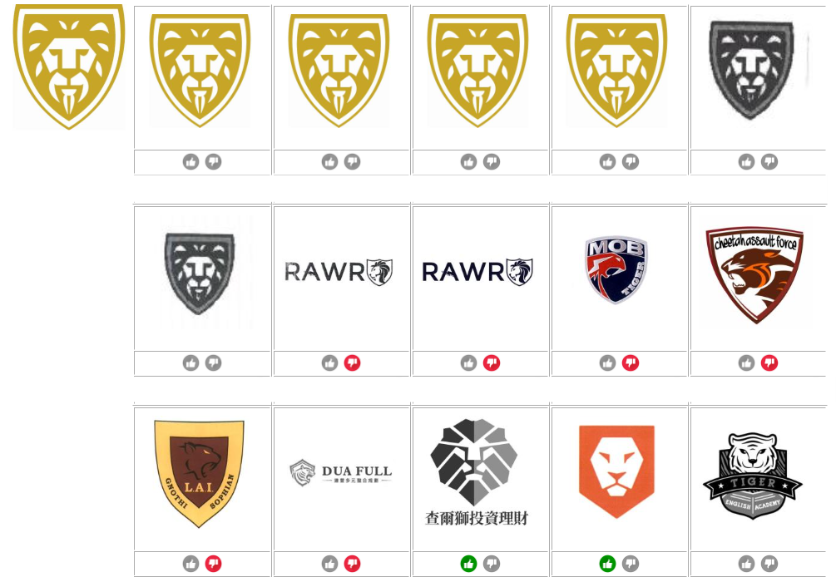


Incorporating Reality Feedback of Examiners
Query image
：Move backward
: Move forward
Or simply click on the image for a

Slide 11


Successful identification of image features (1)

Slide 12


Successful identification of image features (2)

Slide 13
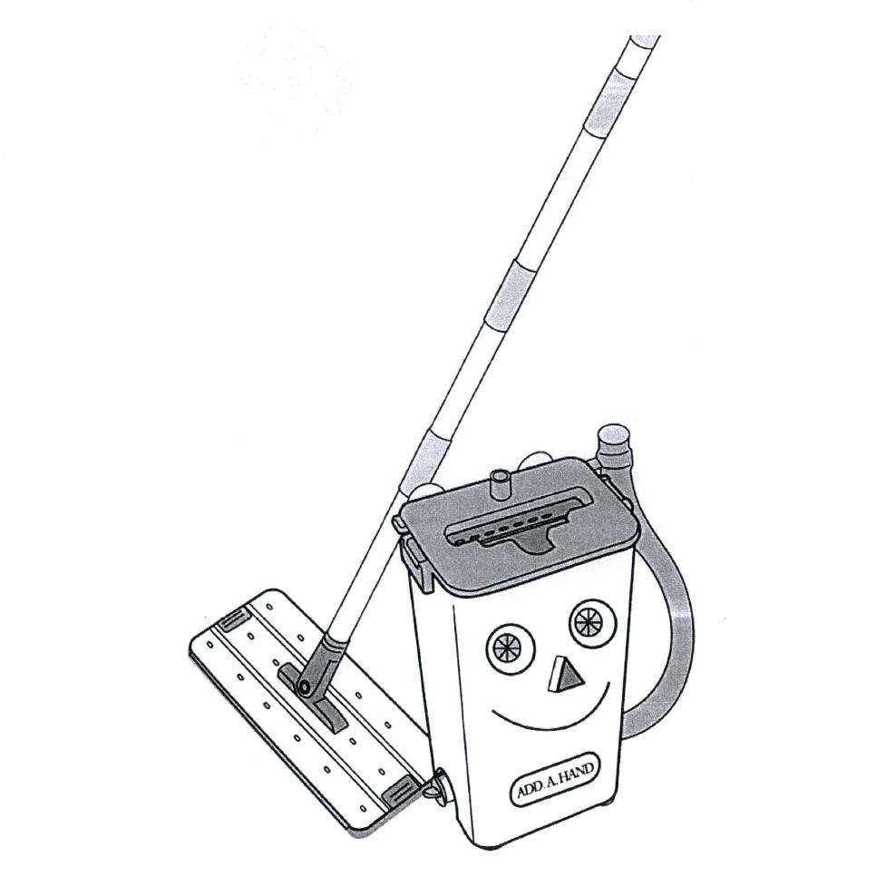

Successful identification of image features (3)

Slide 14
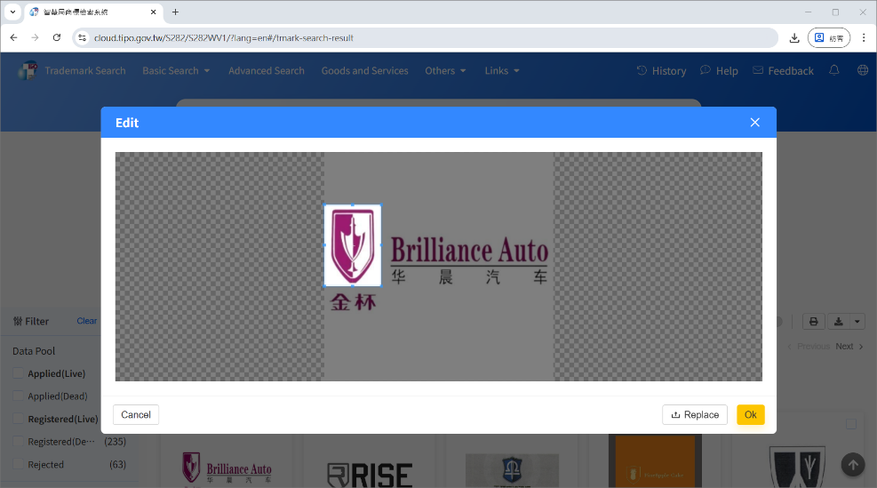
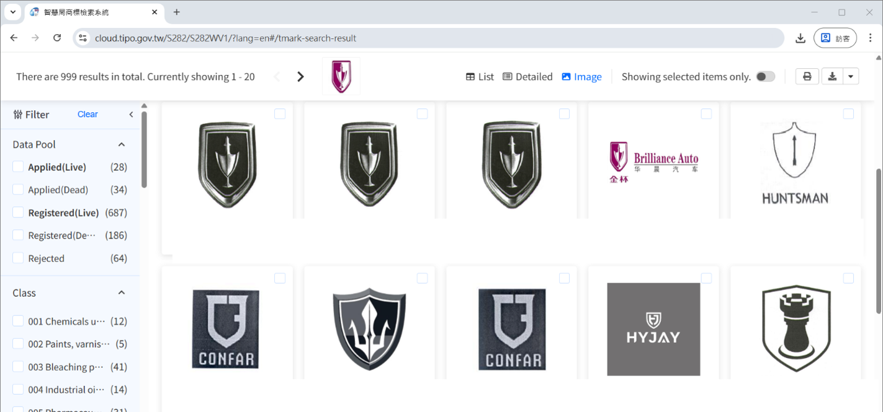
“Select to Search” function
The user selects part of an image, and the AI compares it with both whole images and key parts of images in the database.

Slide 15
High-Frequency Usage Internally and Externally
2025 Total Usage:
38,903 (Internal)
51,074 (External)

Slide 16

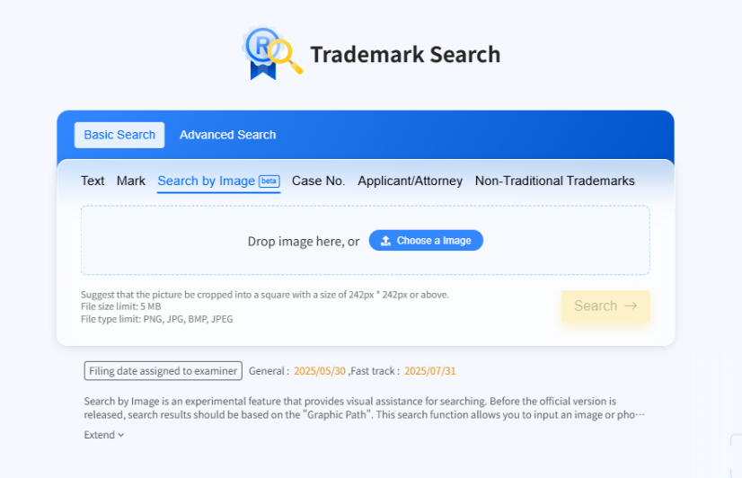


Explore the tool
Search by Image
Thank You

