Slide 1
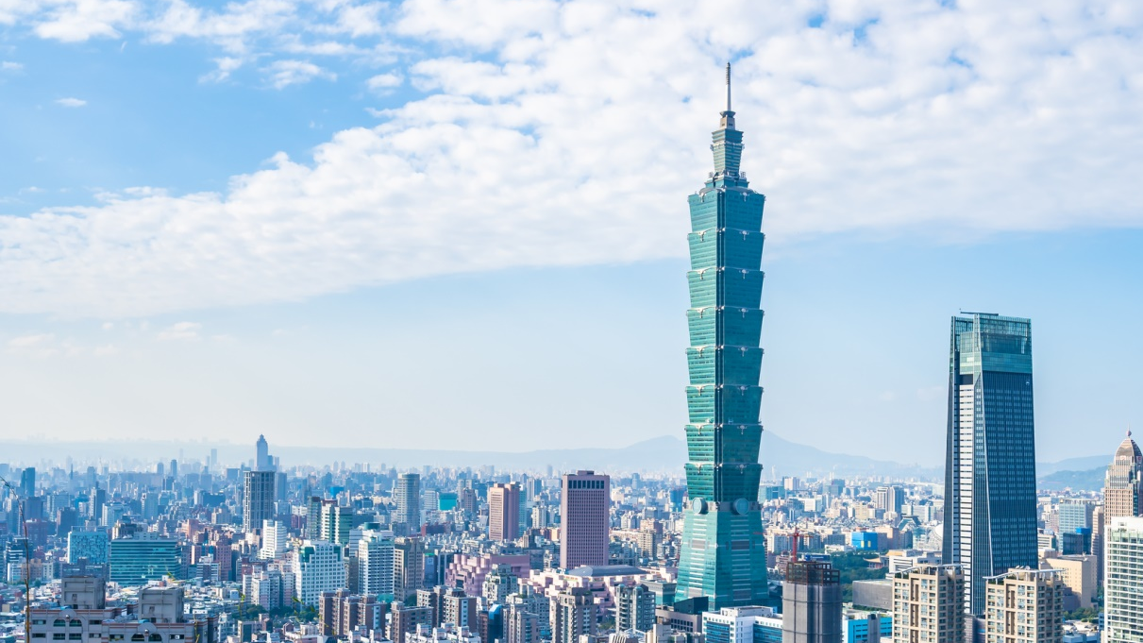

PATENT GO
A New Strategy for Promoting
Patent Products
CHINESE TAIPEI
Feb. 5-6, 2026

Slide 2



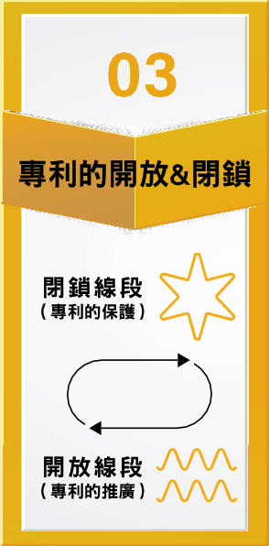


“PATENT GO” Brand Story
Connecting
Ideas
BEST
Exclusivity
& Openness
Where Patents GO Further
Closed curve:
Patent
Protection
High creativity
&
Unlimited possibilities
Open curve:
Patent
Promotion
BEST

Slide 3

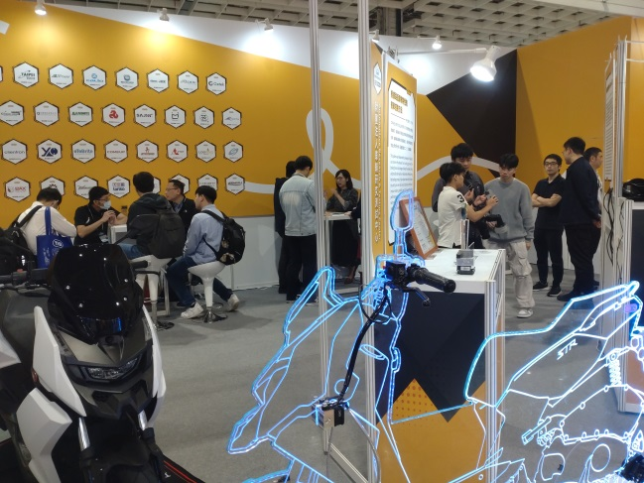
Promoting Innovation through “Patent Go”
“Patent Go” First Stop
In April 2024, TIPO set up the award-winning “Patent Go” pavilion at the Taipei International Auto Parts & Accessories Show (TAIPEI AMPA 2024) held at the Taipei Nangang Exhibition Center.
Provide opportunities for technology matching and business expansion
“Patent Go” showcased promising, award-winning patent technologies by providing exposure through diverse displays and promotional activities, recommending them to professional buyers, and facilitating matchmaking opportunities.
in Taipei AMPA 2024

Slide 4

The “Patent Go” Journey Across Professional Exhibitions (2024-2025)
2024
TAIPEI AMPA
DESIGNED GIFTIONERY
INNOTECH EXPO
2025
TIMTOS
DESIGNED GIFTIONERY
MEDICAL
INNOTECH
EXPO

Slide 5
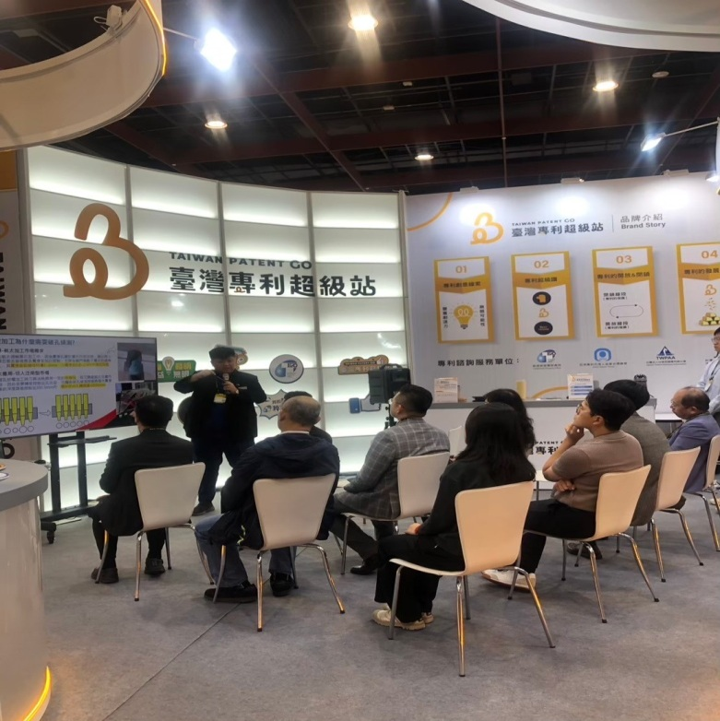
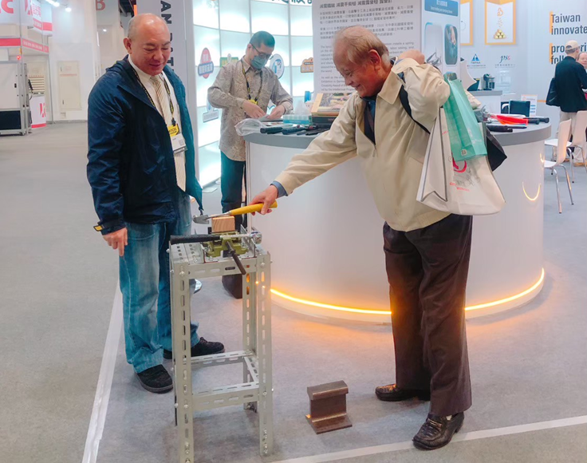
”PATENT GO” in Various Professional Exhibitions
2025 TIMTOS
Patent Technology
Presentation
2025 TIMTOS On-site operation
force limiter dampening device

Slide 6
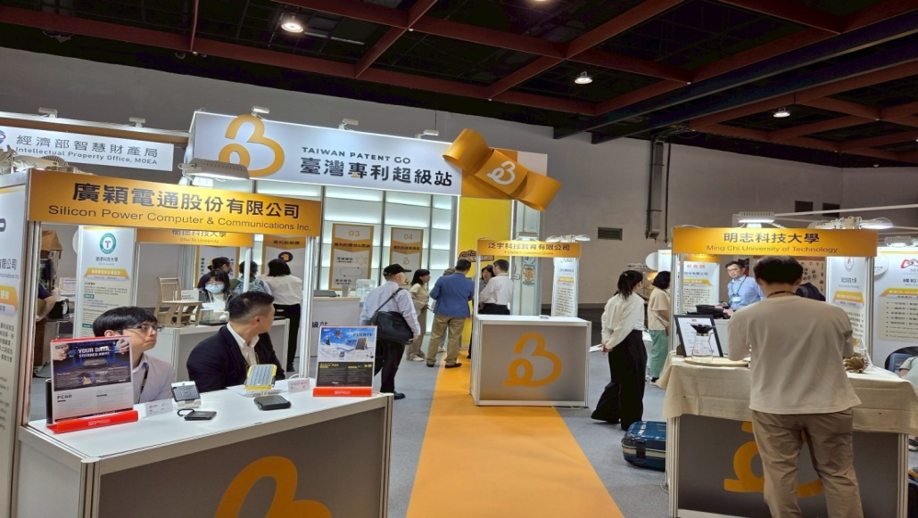
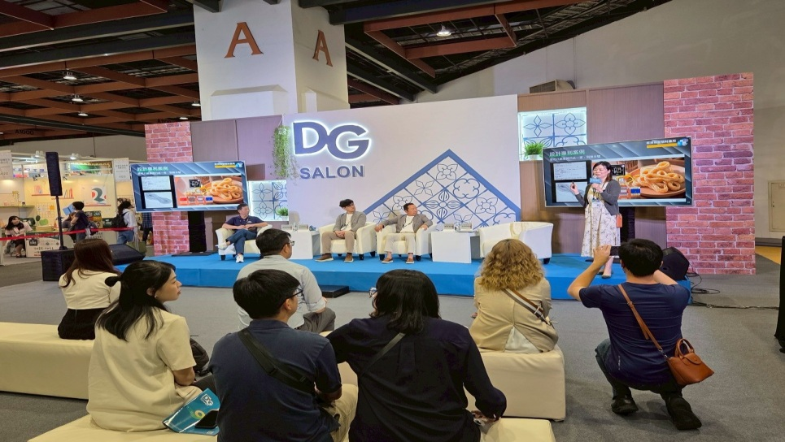
”PATENT GO” in Various Professional Exhibitions
2025 DESIGNED GIFTIONERY(DG)
Patent Technology Presentation
”PATENT GO” in 2025 DG

Slide 7
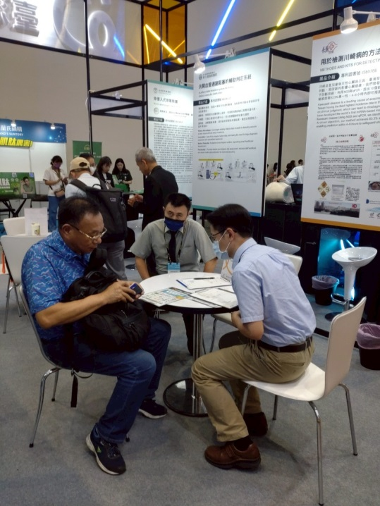
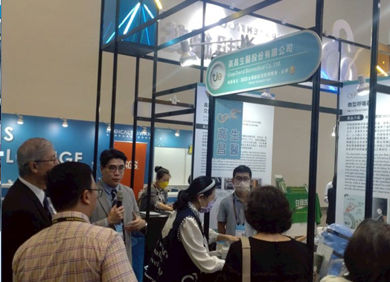
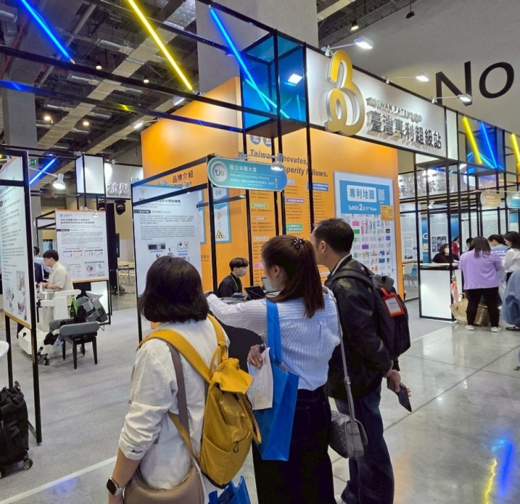
”PATENT GO” in Various Professional Exhibitions
2025 Medical
Patent Consultation
Services
”PATENT GO” in
2025 Medical
Introducing the exhibits to the Myanmar Pharmaceutical and Medical Equipment Association delegation

Slide 8

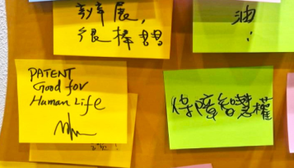
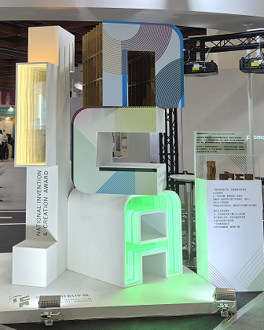

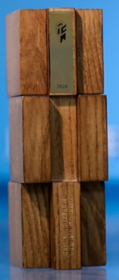
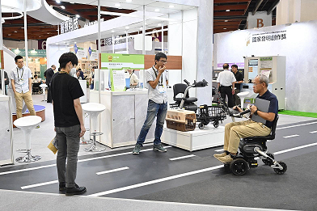
”PATENT GO” in Various Professional Exhibitions
2025 INNOTECH EXPO (tie)
1
Sticky Note Message Activity
Highlight Exhibits—Walker(WISTRON)
NICA Trophy Display
3
2

Slide 9



Conclusion
Innovation Drives Prosperity

Slide 10

Thank you for your attention!
10

